Slide 1
Early diagnosis of Parkinson’s disease using machine learning algorithms
Zehra Karapinar Senturk
Presented by Asika Islam
Id:22273013

Slide 2
Introduction
Parkinson’s is a slow progressing neurodegenerative brain disease. It is caused by the disruption of the brain cells that produce substance to allow brain cells. The cells that produce dopamine in the brain are responsible for the control, adaptation and fluency of movements. Normally brain cells produce dopamine in certain regions of the human brain. These cells are concentrated in a certain area of the brain called substantia nigra. Dopamine is a chemical that transmits messages between the substantia nigra and other brain regions that control body movements . Dopamine allows people to make smooth and harmonious movements. . In this paper, machine learning based diagnosis of Parkinson’s disease is presented.

Slide 3
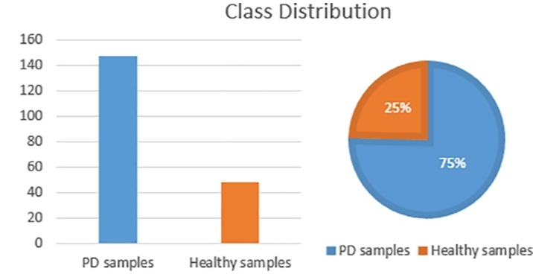
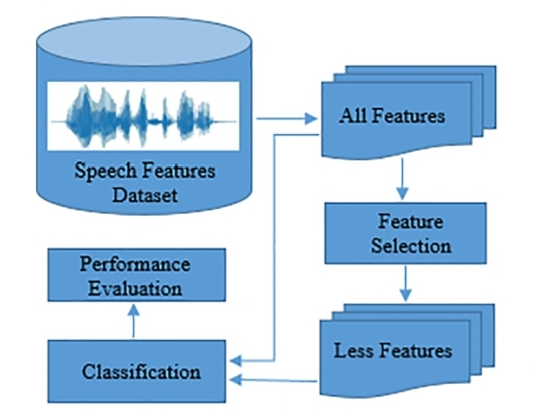
Methods
Feature selection was performed on the 23 voice features. By performing FS, only the effective features were used and the cost of the analysis was reduced. Different FS algorithms were applied for different classification methods. New feature subsets and classifications were generated by using these algorithms from the original feature set. Performance of the model was evaluated based on multiple criteria. FS has many advantages such as saving time for future data collection, understanding causes of diseases, less computational cost, no degradation in performance. In this paper used FS for the diagnosis of PD.

Slide 4
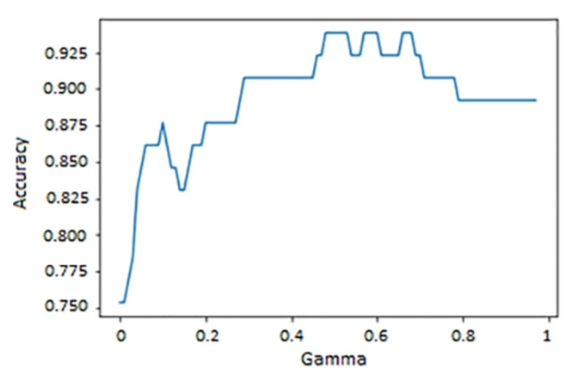
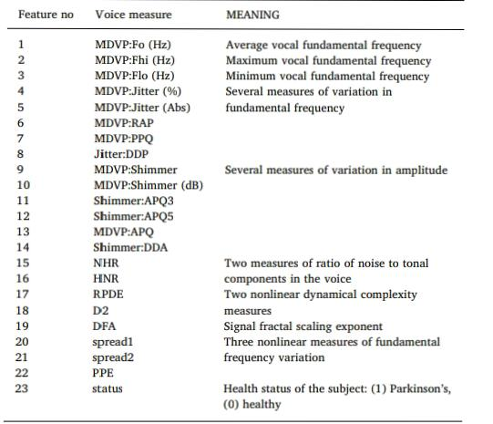
Experiment
The determination of the
most relevant features increases the classification performance in acvordance with the literature. RFE method made SVM the most successful classifier for PD diagnosis while it was the worst before FS.

Slide 5
Discussion
PD diagnosis system proposed in this study differs from the literature in terms of FS method, a lightweight feature extraction process and a classifier. A high enough classification performance has been achieved. Using voice features in the diagnosis of PD helped very much. Obtaining voice features are both easier and cheaper when compared to MRI-based or motion based diagnosis methods. In this study, SVM with RFE gave the best classification accuracy. These findings suggest that using certain subset of voice features help researchers classify PD patients more accurately and less efforts can be made to extract features From voice signals of candidate PD patients. Besides, the classification can be realized by less computational cost.

Slide 6
Conclusion
In this paper, FS based decision support system was developed using the features of voice signals of both PD patients and the healthy people for the early diagnosis of Parkinson’s. Different FS methods and different classification methods were used in the experiments. The primary objective in doing so was to improve the performance and the accuracy of the model and also to reduce the computational cost of classification task. Accuracies of the classification methods were evaluated with and without FS and the remarkable effect of FS was shown. The results indicate that using FS methods together with classification methods is quite advantageous especially when dealing with speech signals in which hundreds of phonetic features can be obtained. By the help of the developed early diagnosis system, PD can be diagnosed with a high accuracy rate in its early stages and the worse symptoms of the disease can be stopped.

Slide 7
Thank you

